Slide 1
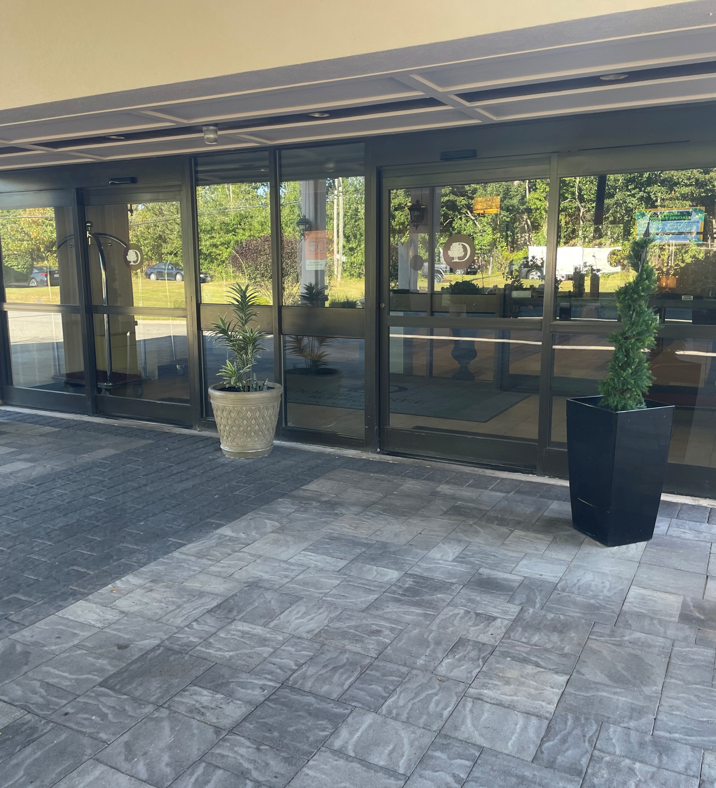
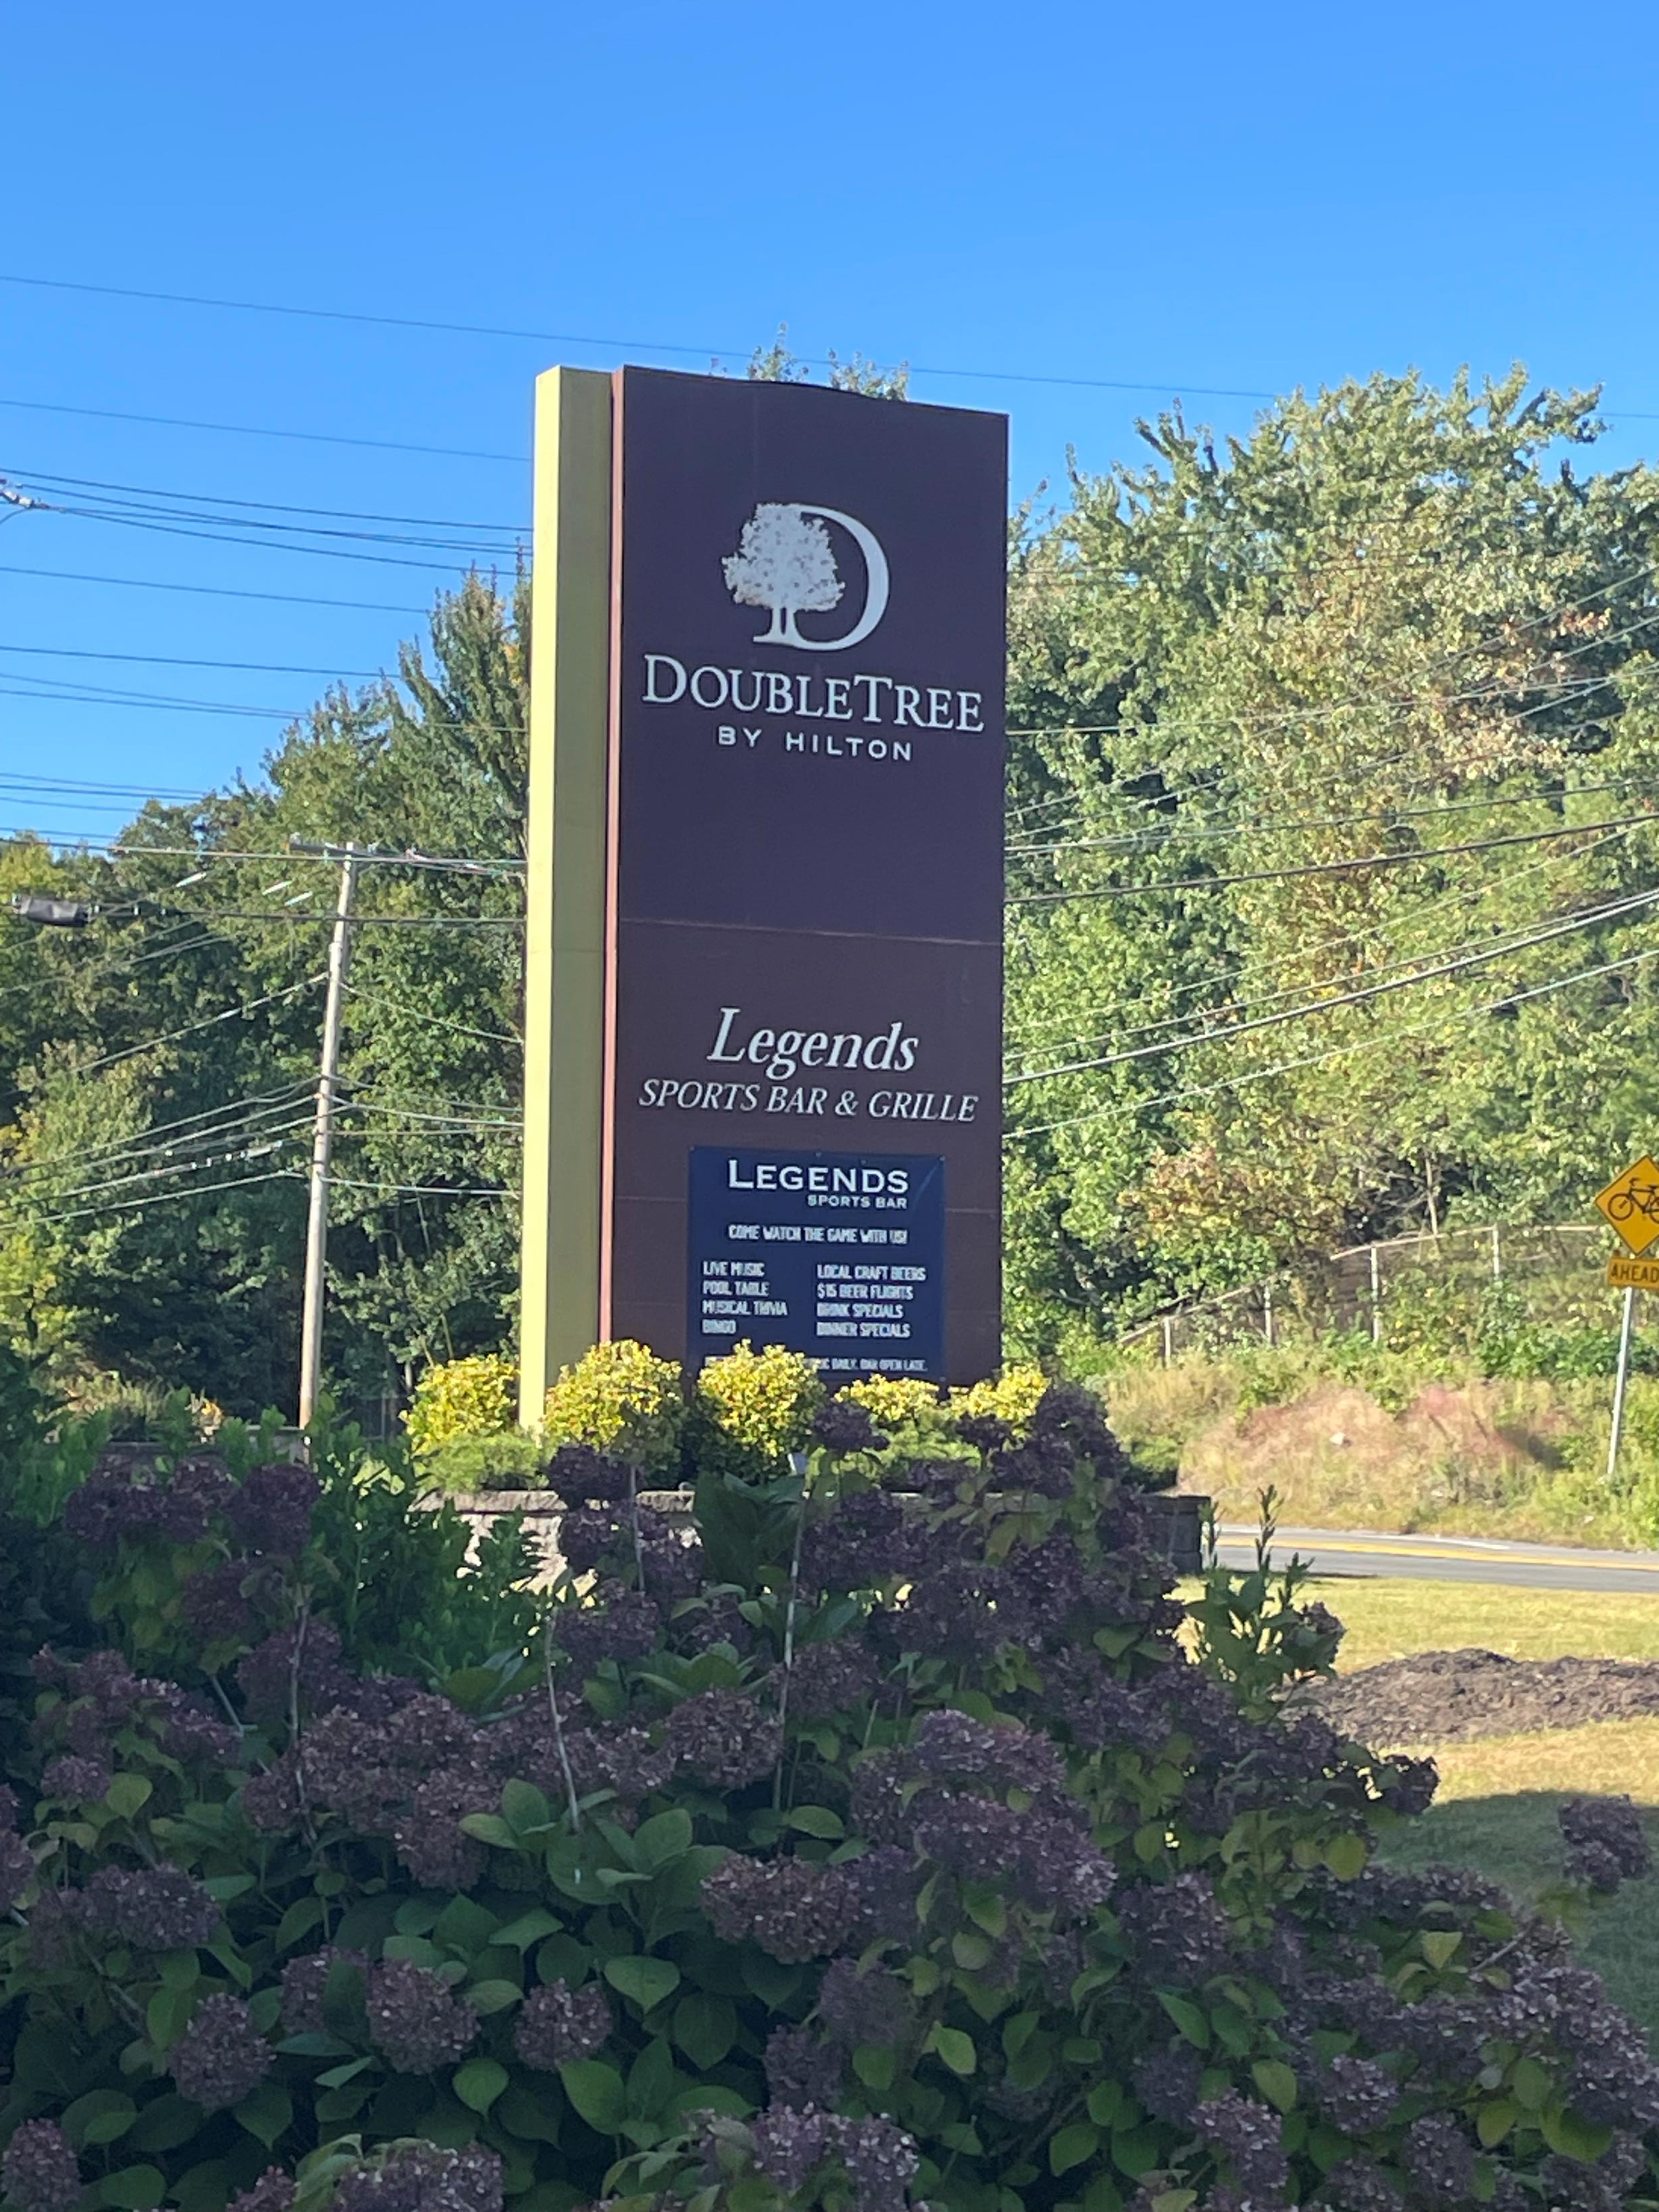
Swimming Lessons with the British Swim School at DoubleTree Hotel
With the Autism Resource Center and Worcester County District Attorney’s Office

Slide 2
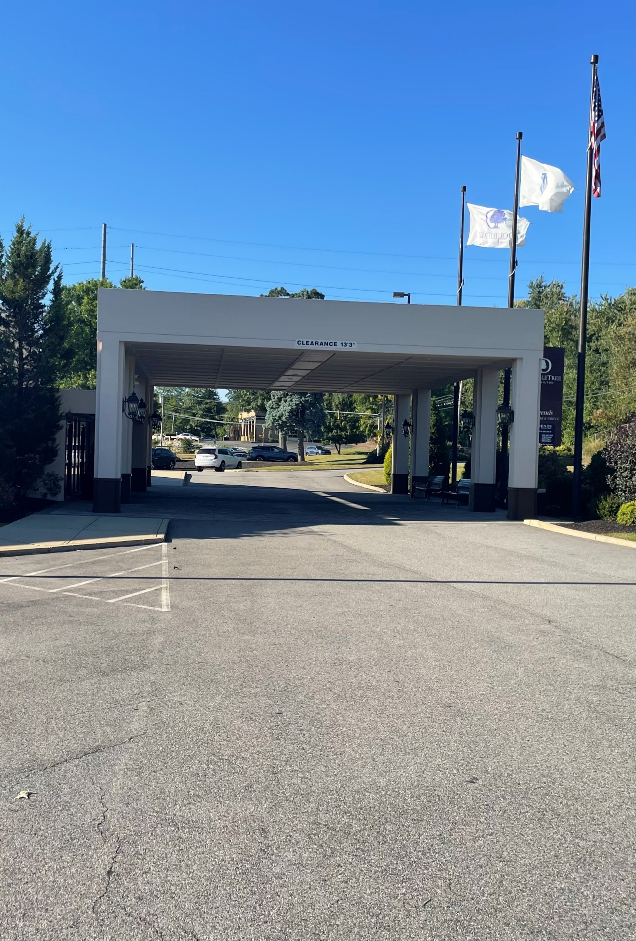
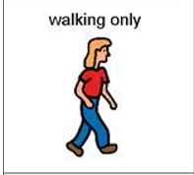
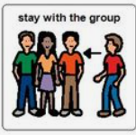
I am going to swim lessons with the British Swim School. When we get there, we will park the car and I walk safely to the building.

Slide 3
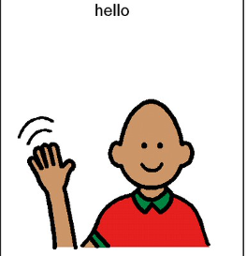
Swimming lessons are fun! I am excited to learn how to swim better. When I get to the British Swim School, I will see my teacher and my classmates. The teacher is there to help me learn. The other kids are there to learn too.

Slide 4
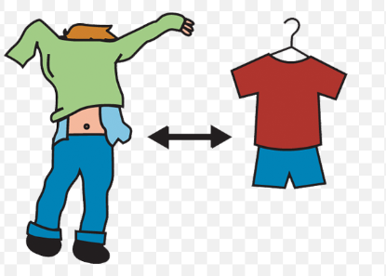
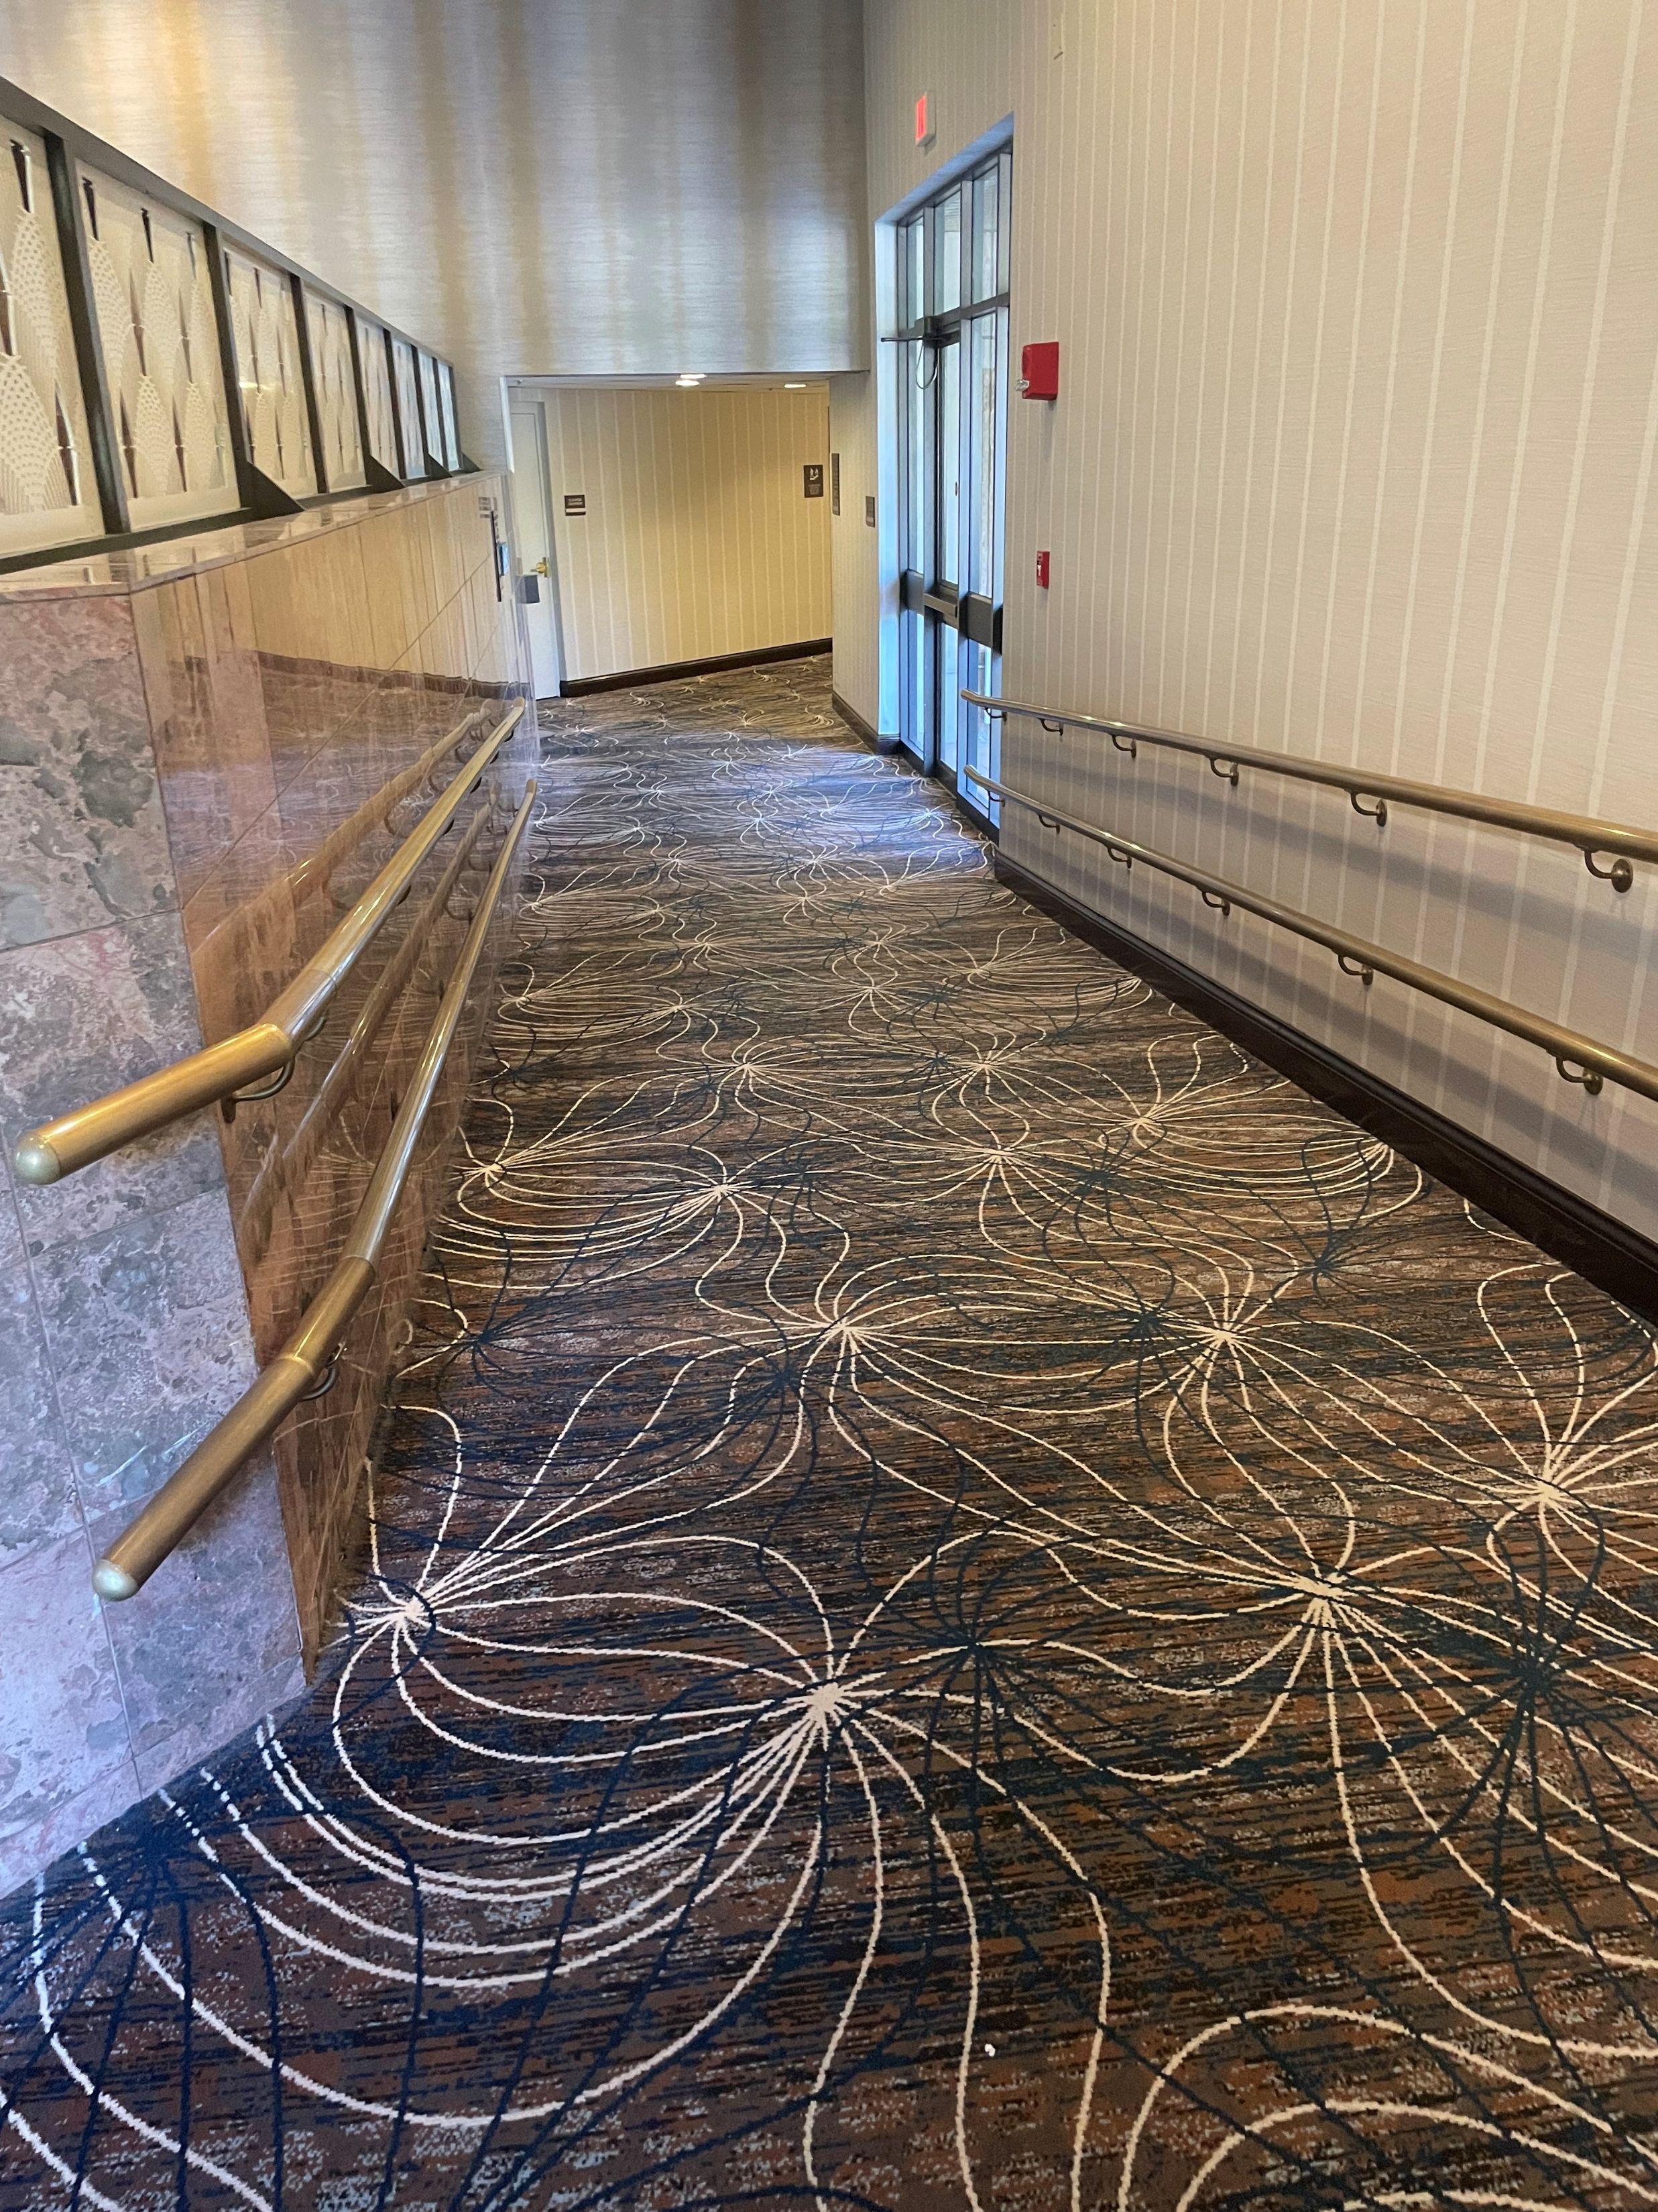
Before we start swimming, I will walk to the bathroom and change into my swimsuit. I can ask for help if I need it. It’s great that I have my towel ready.

Slide 5
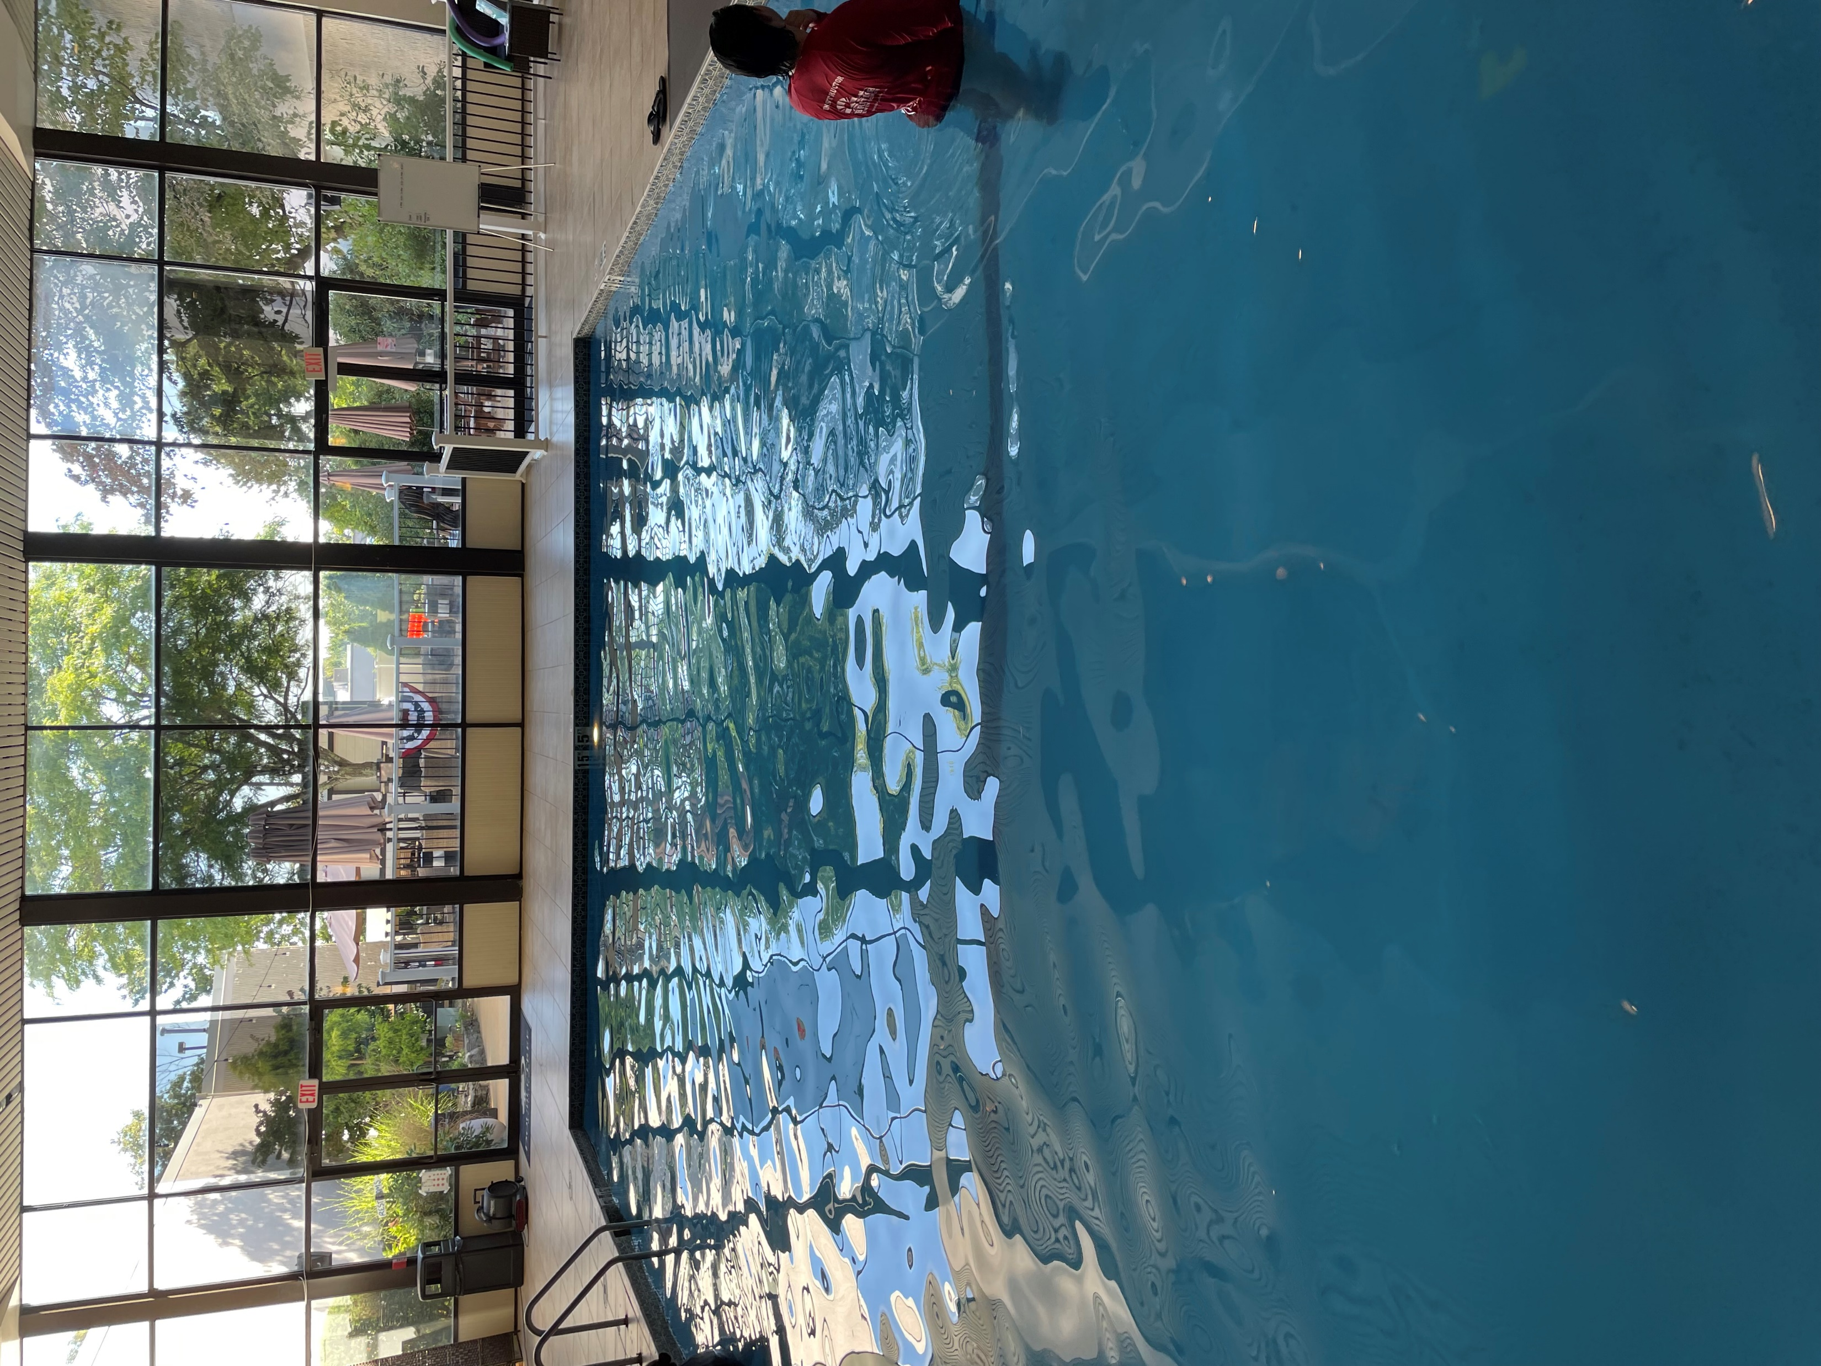
In swimming lessons, I will learn new skills. I will practice floating, kicking, and breathing in the water. I might feel a little nervous, but that is okay! I can take deep breaths to help me feel calm.

Slide 6
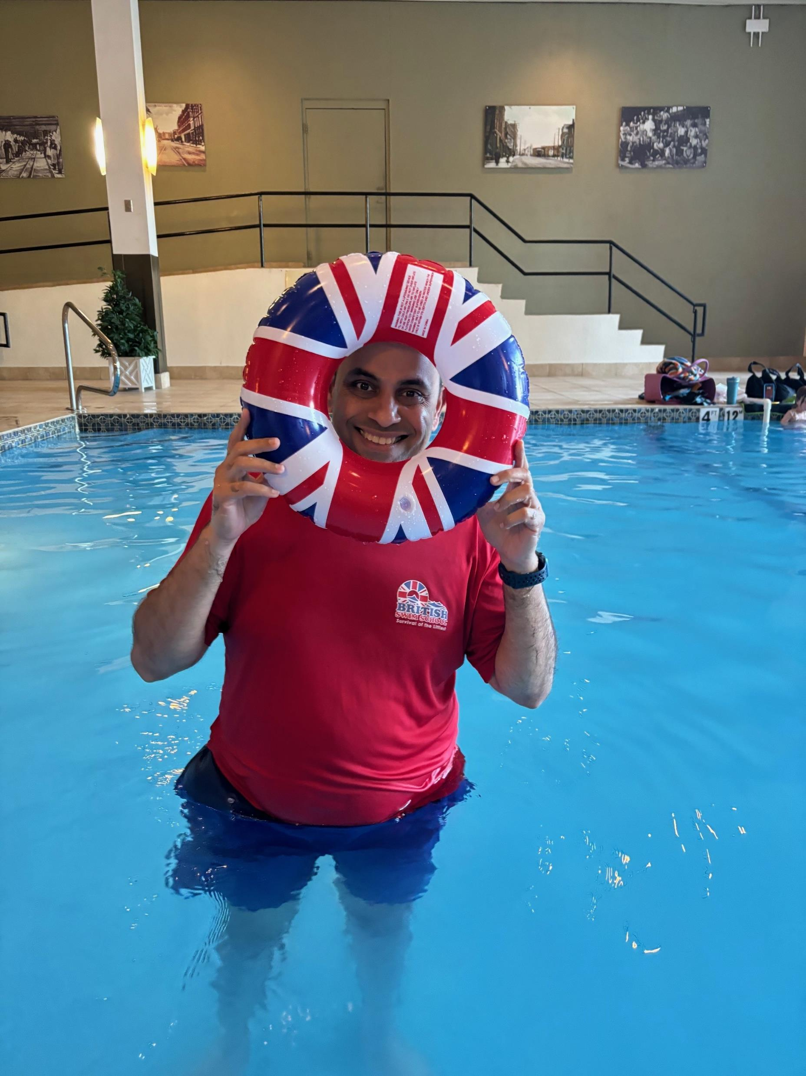
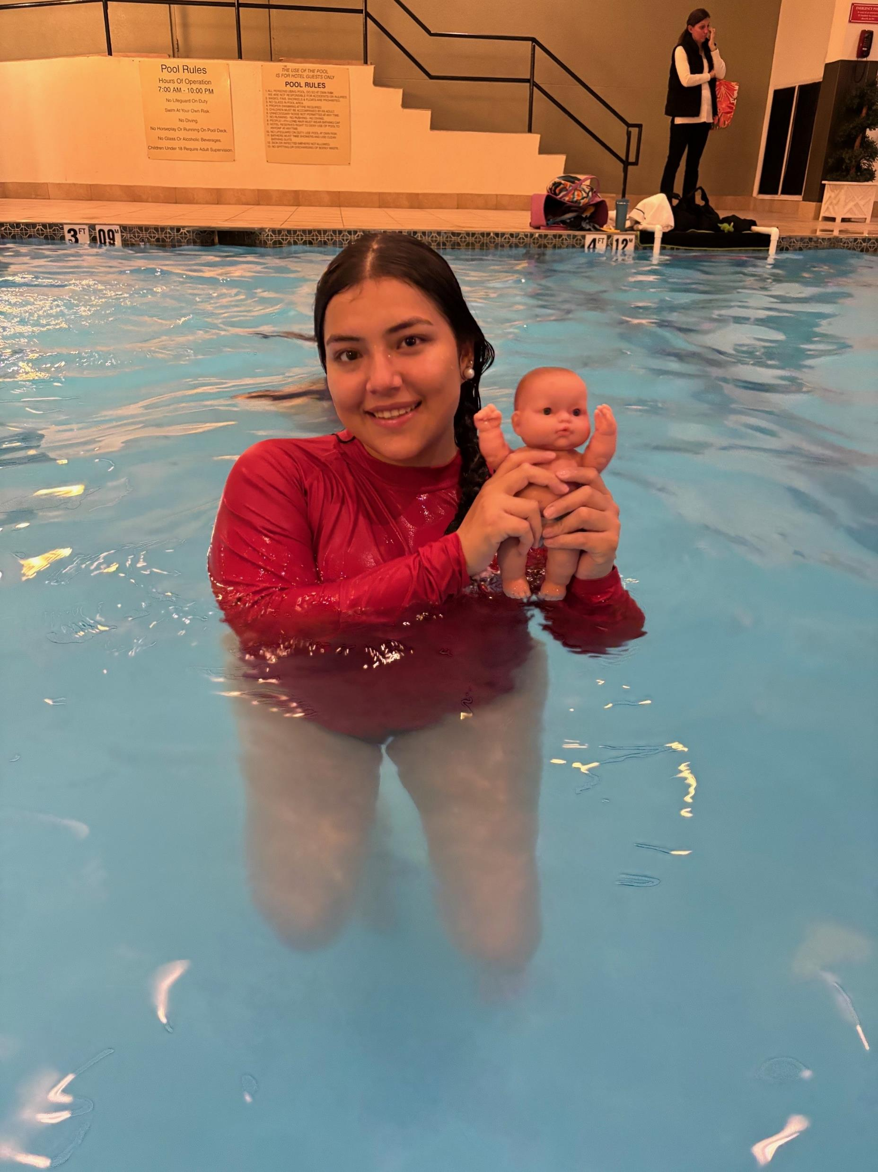
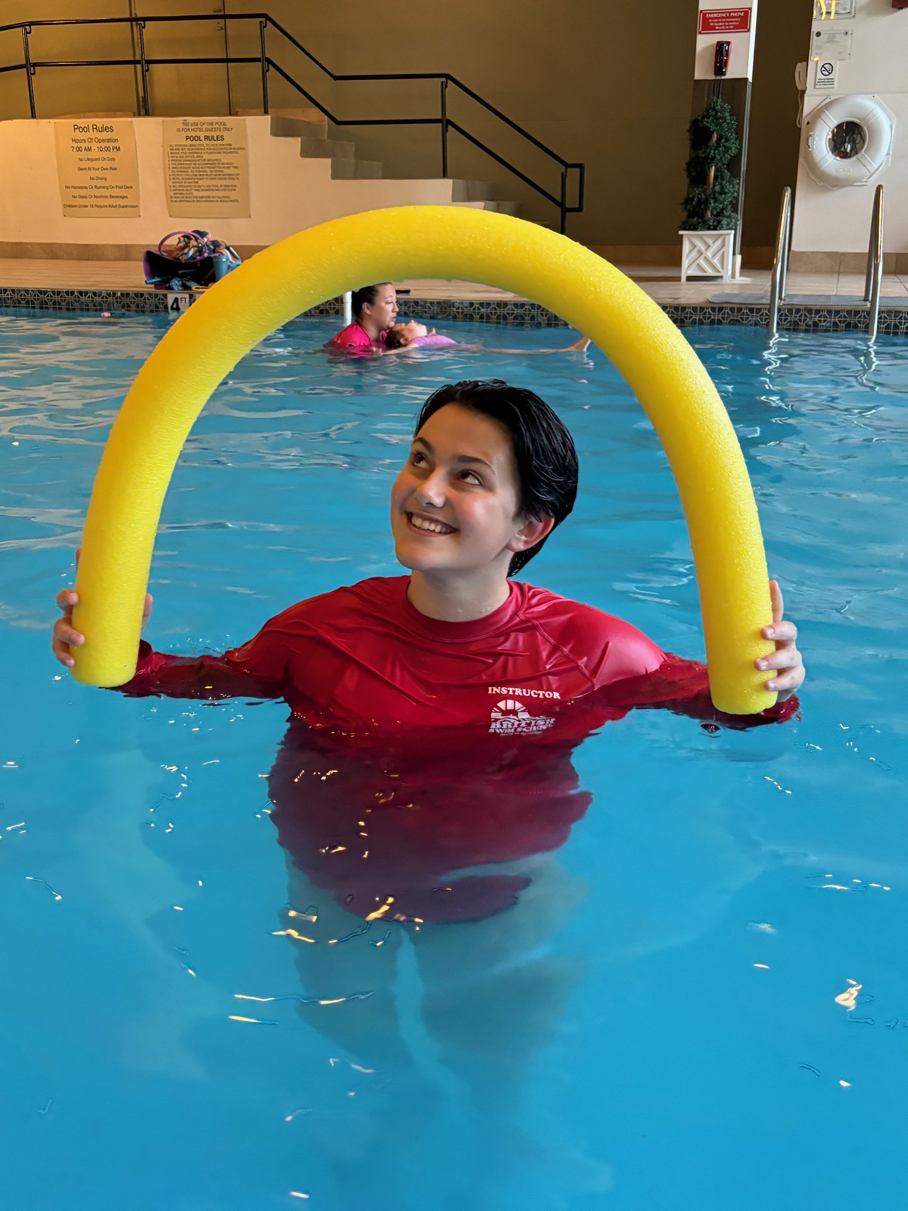
Logi, Anusha, Mikaela or Zoie will be my swim instructor! They will help me learn to swim!

Slide 7
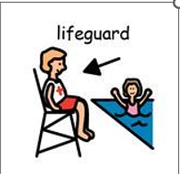
If I have questions, I can raise my hand. If I feel unsure, my teacher will help me. It's nice that my friends can cheer me on when I do a good job.

Slide 8
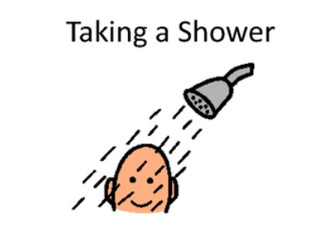
After swimming, I will dry off and change back into my clothes. I may be asked to take a shower. I will feel proud of myself for trying my best!

Slide 9
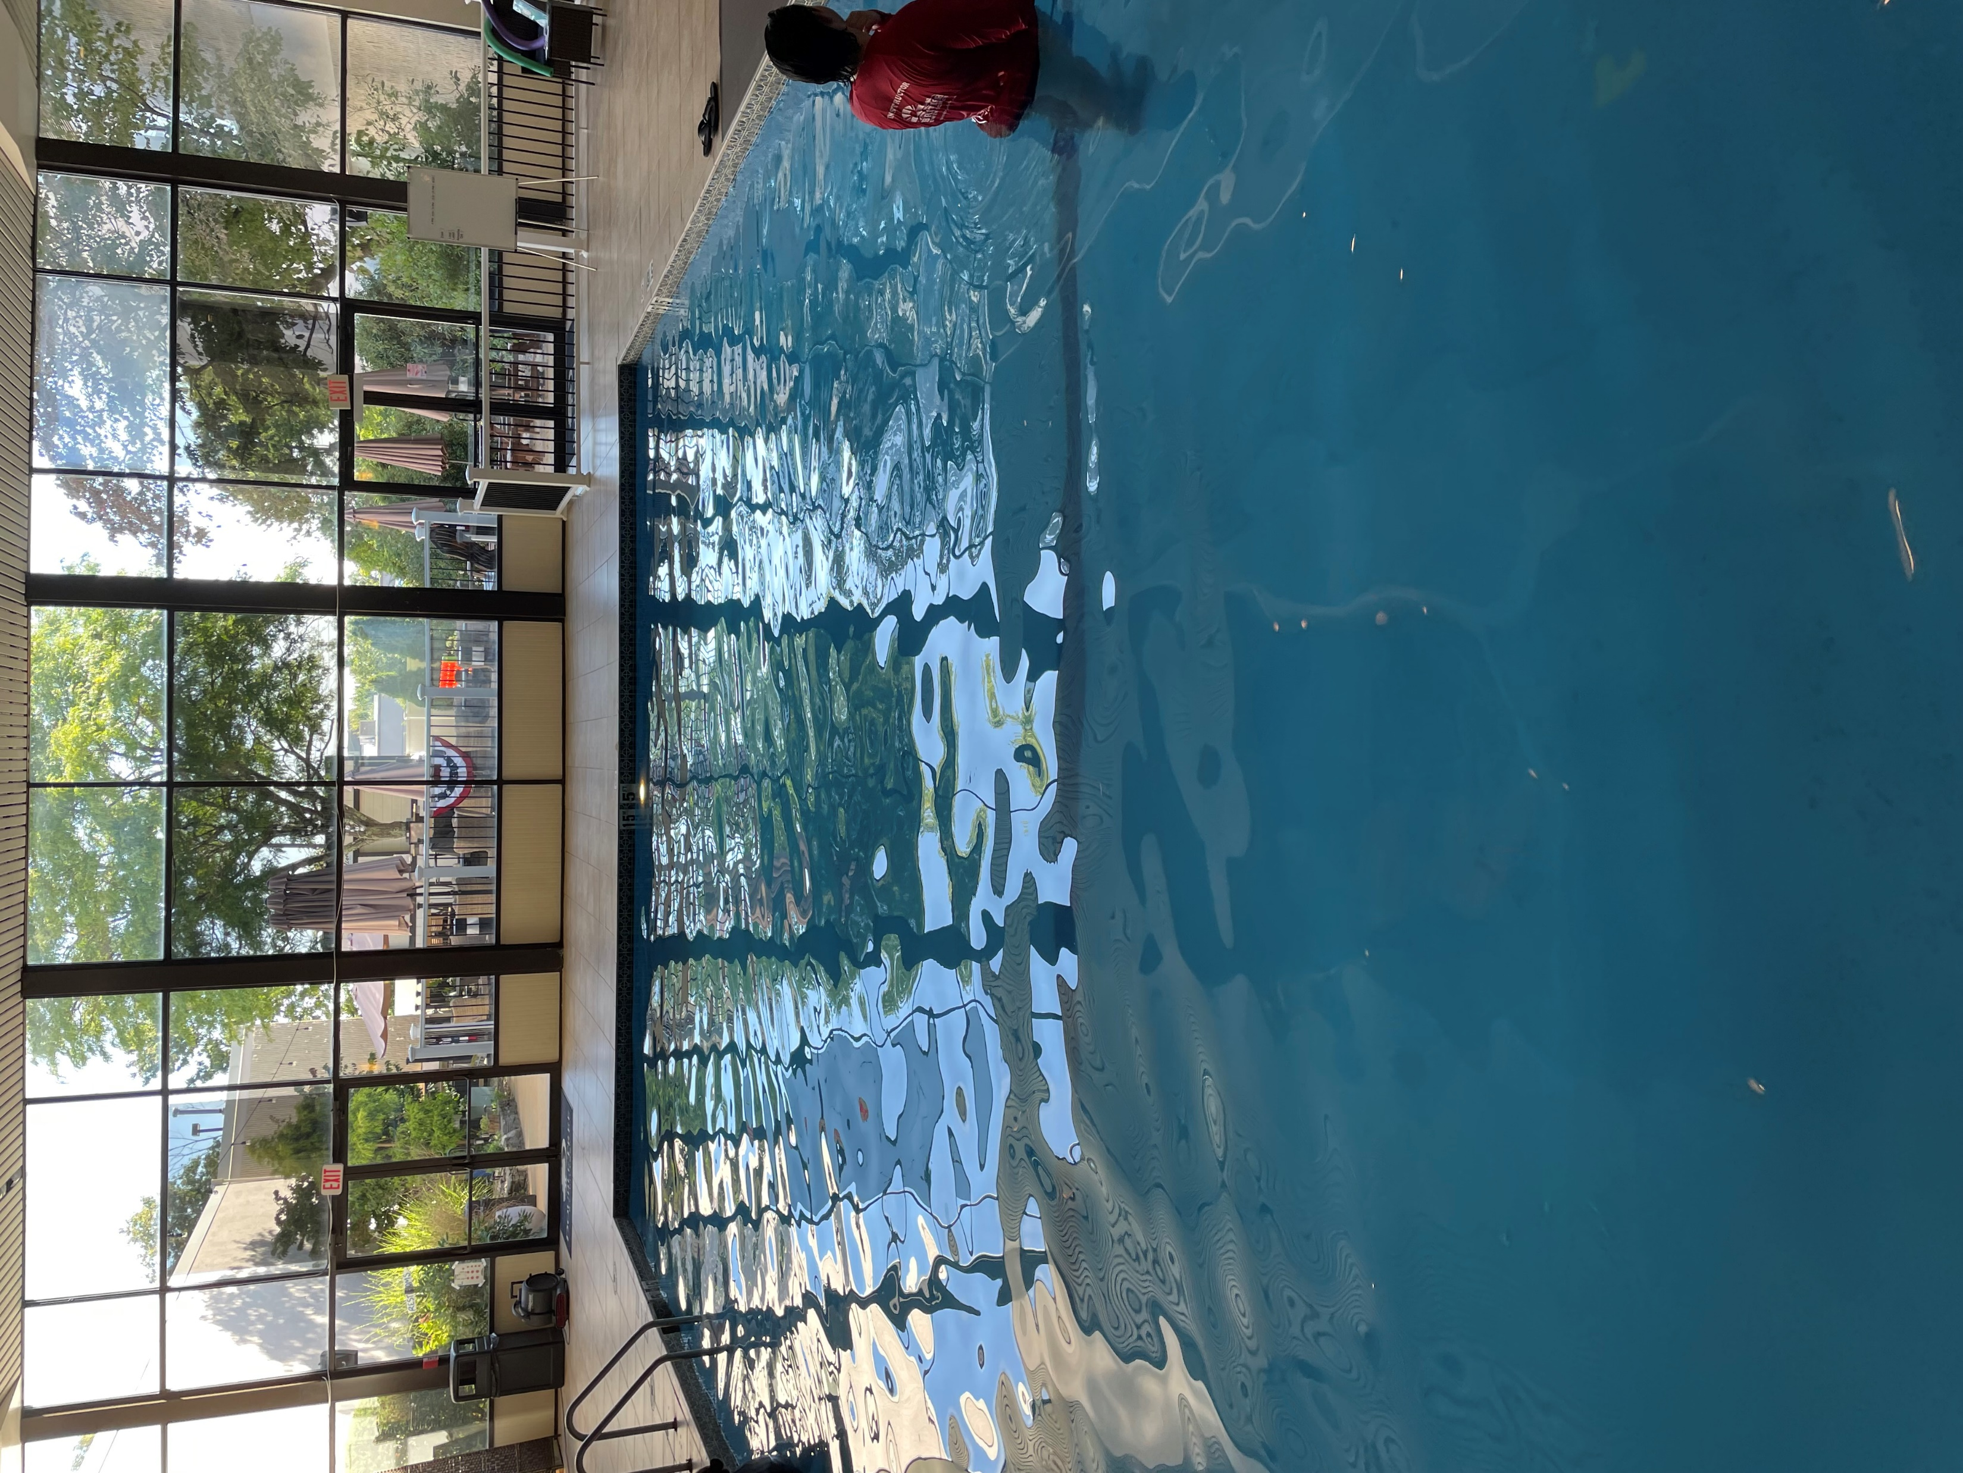
I am excited to go to swimming lessons at the British Swim School. I will have fun and learn new things!

